Slide 1
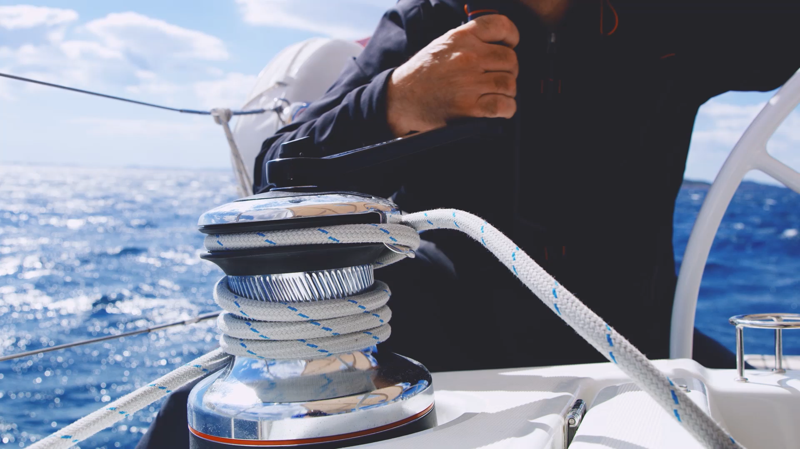
SeaSafe – Ship Collision Avoidance Simulator
Guy Pariente Almog Elbaz
Supervisors: Dr. Edi Shmueli Prof. Miri Weiss Cohen

Slide 2
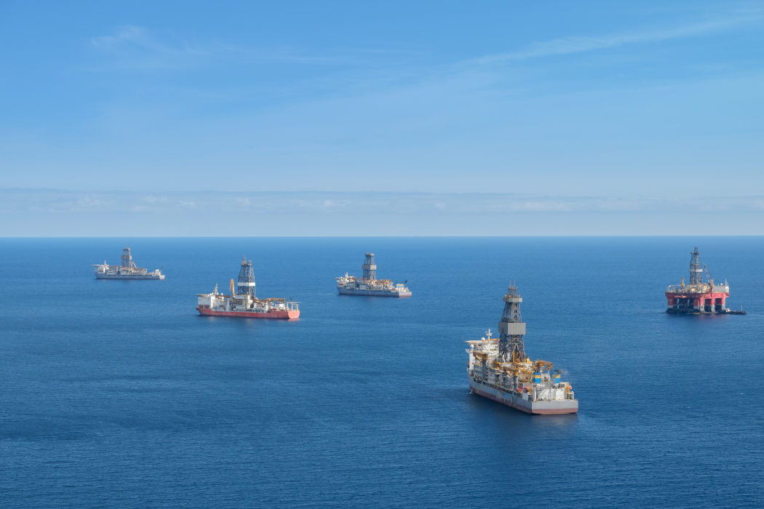
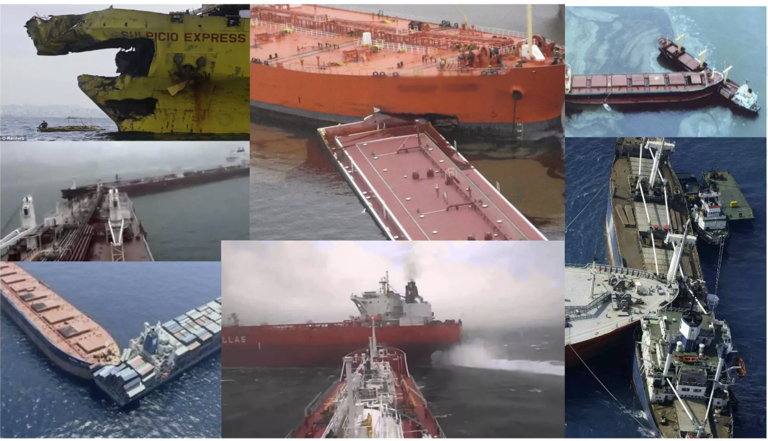
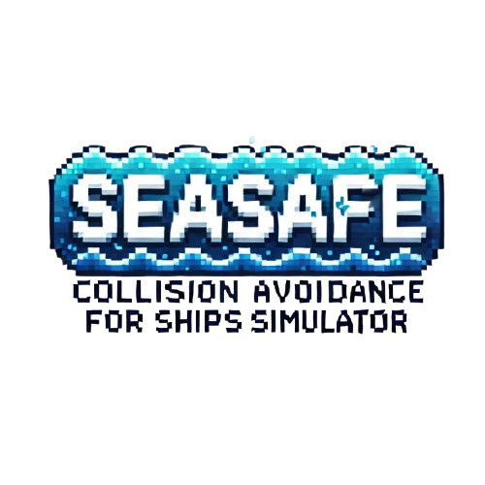
INTRODUCTION
Shipping industry accounts for over 80% of global trade volume. As the volume of maritime traffic increases, the potential for accidents rises.
Our goal – create collision avoidance algorithm for vessels.
Notes:
First – Importance of maritime transportation. Second point – “more congested waters mean more danger of such collisions as we can see in the right image” , Those collisions not only can damage cargo but can damage lives.

Slide 3
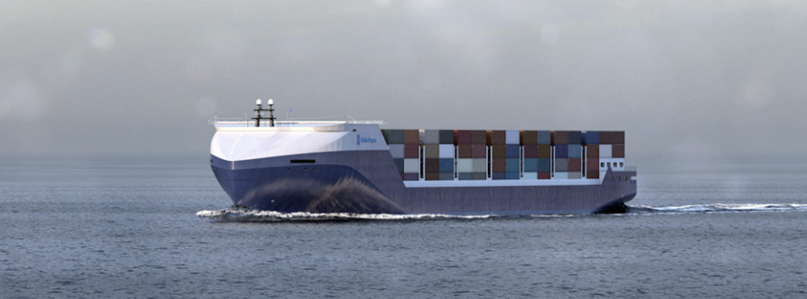
PROBLEM DEFINITION
In an open sea environment with only autonomous vessels, each starting simultaneously from source points toward their destinations, the goal is to ensure that all ships reach their destinations safely.
Compliance with current maritime navigation rules.
Notes:
You might be asking your self – why autonomous? Because a research showed that 80-85% of maritime accidents are attributed to human error. Second point is “Constraint we have – compling with current maritime navigation rules.”

Slide 4
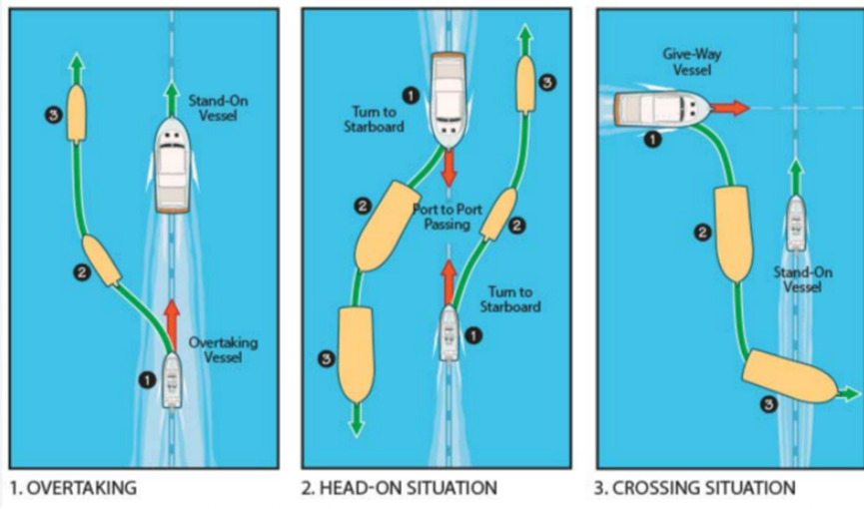
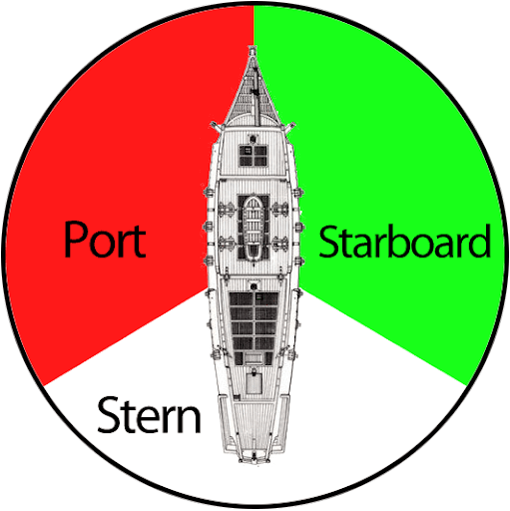
COLREG
IMO(International Maritime Organization) established COLRG – Convention on the International Regulations for Preventing Collisions at Sea.
COLREG sets out the rules that all vessels must follow to prevent collision. Just as there are rules to be followed by car drivers, there are rules to be followed by vessels.
Notes:
When everyone is guided by a rules, the actions of other vessels can be predicted, and therefore right decision can be made. These 3 rules are small part of COLREG, but we chose to focus on them.

Slide 5
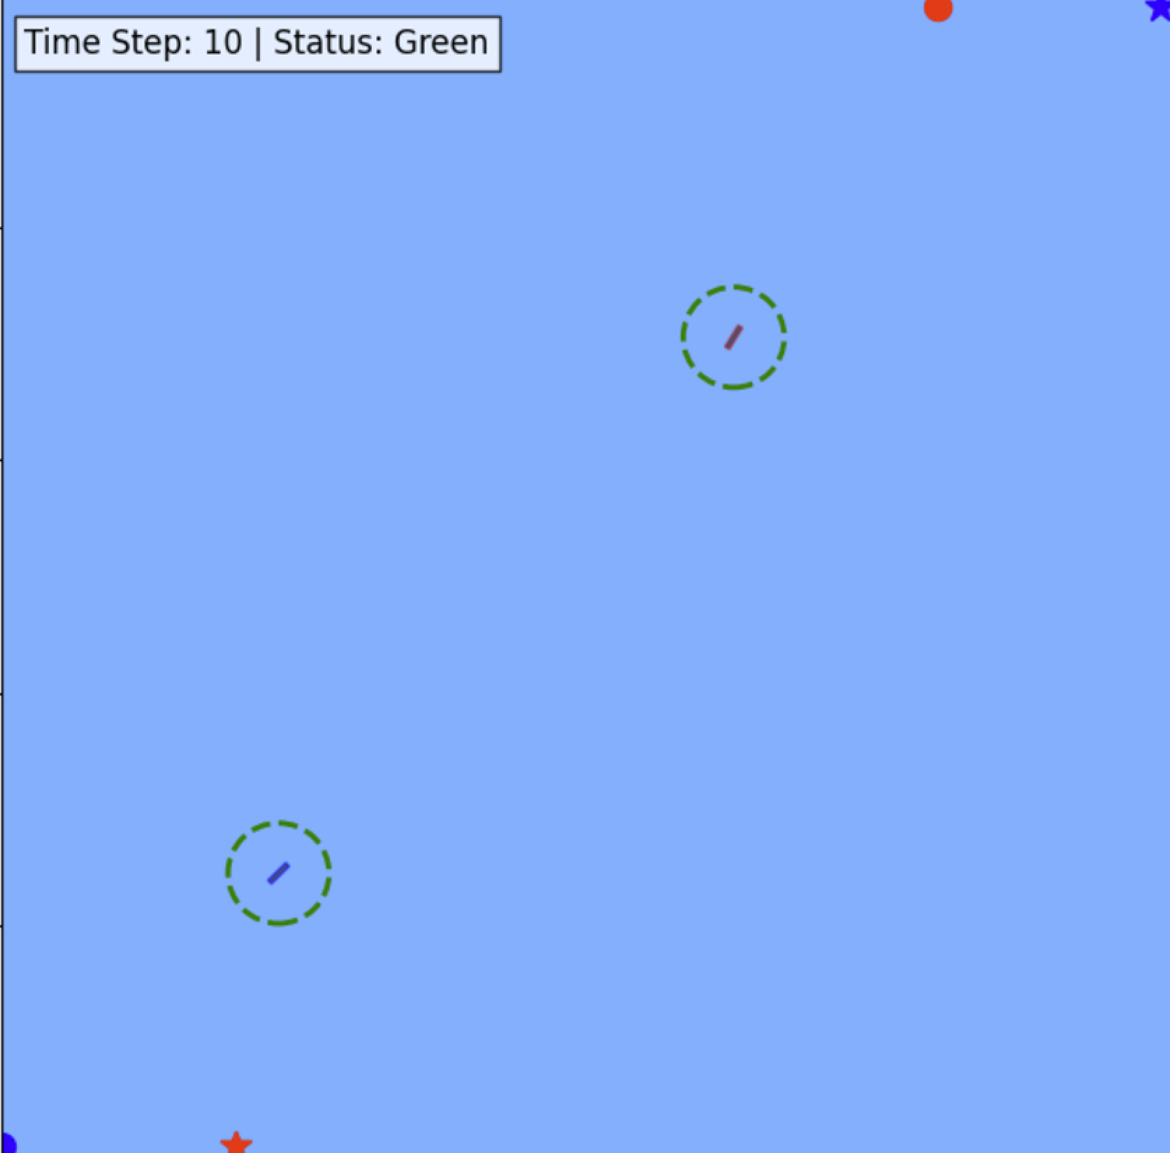
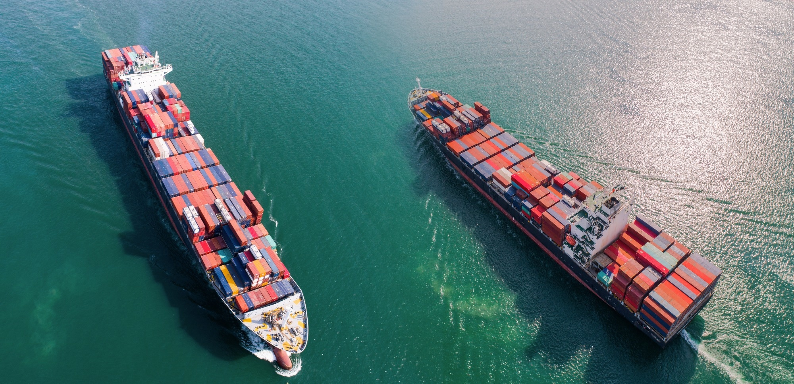
GOALS
Theoretical goal - Develop an algorithm for collision avoidance that complies to COLREG.
Practical goal - develop a simulator that runs our algorithm.

Slide 6
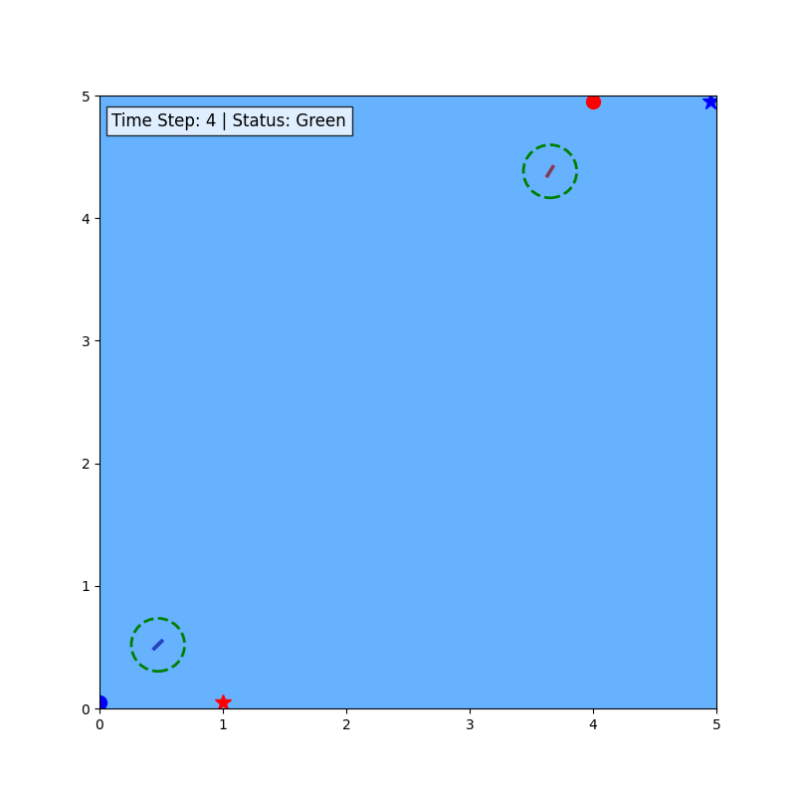
ENVIRONMENT
Safety zone: a circular area around the ships with configurable radius e.g., 50m.
Horizon - the lookahead distance considered by the vessels when searching for potential collision and for collision avoidance maneuvering.
- Time step - An interval in the simulation during which the system updates the state of all ships.
Safety Zone
Horizon
Horizon
Safety Zone
Notes:
All are configurable

Slide 7
FLOW
Collision Detection
Scenario Classification
Roles Appliance
Collision Avoidance Algorithm

Slide 8
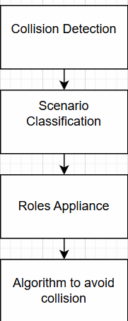
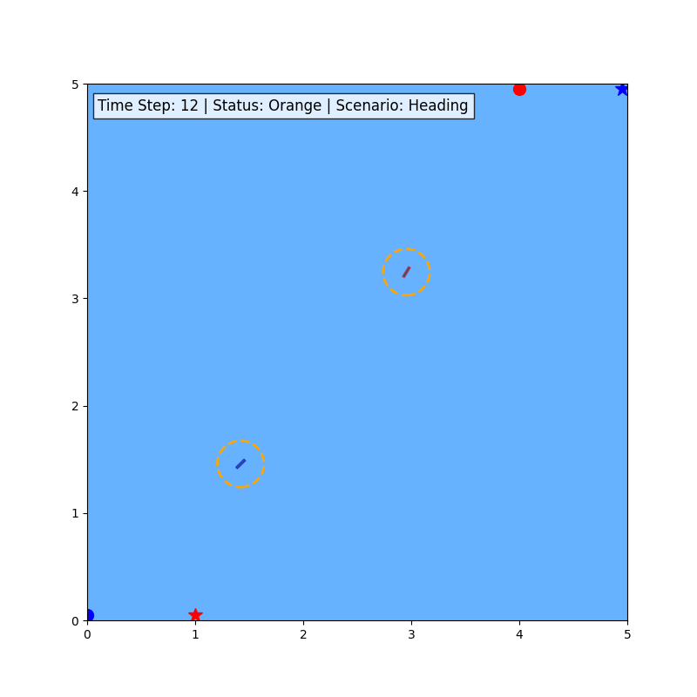
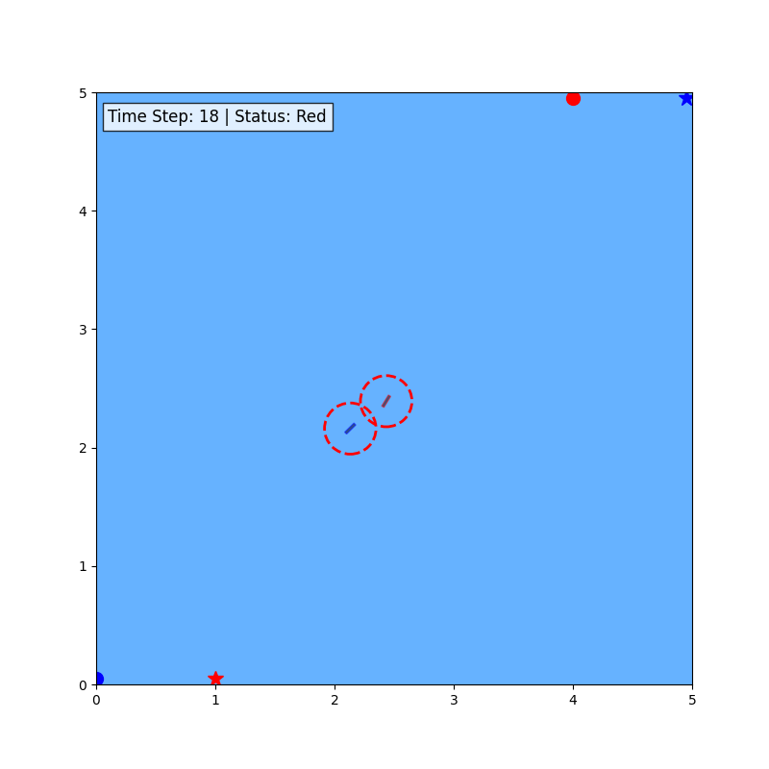
Collision detection
Collision – a case where two or more ships enter each other’s Safety zone.
At each time step, the algorithm search until the horizon for collision.
Safety Zone
Horizon
Horizon
Safety Zone
Notes:
You can see in the images that the status of the ships is changed – collision is predicted at the orange status.

Slide 9
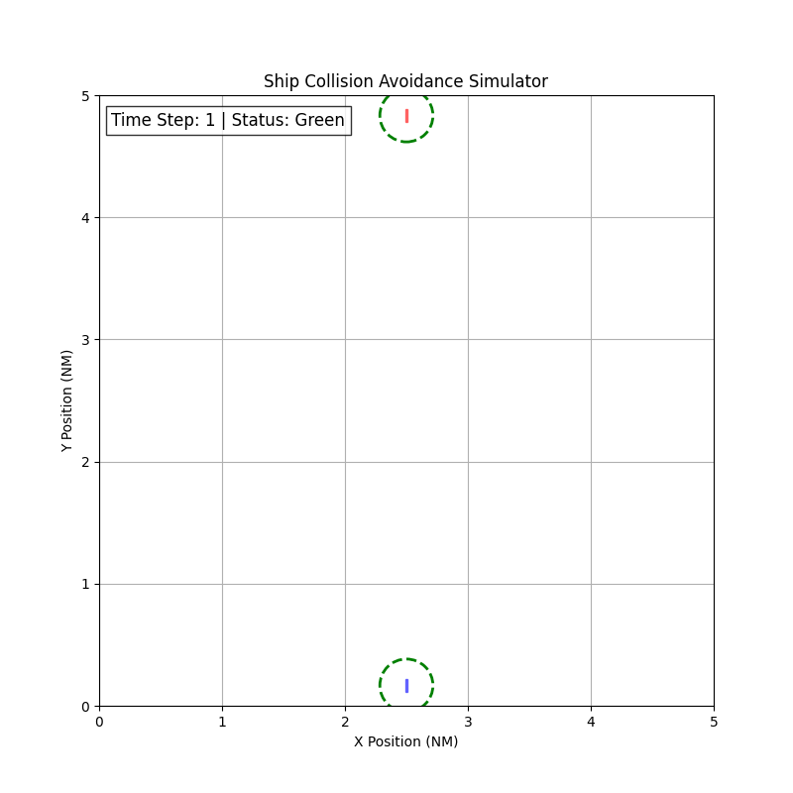
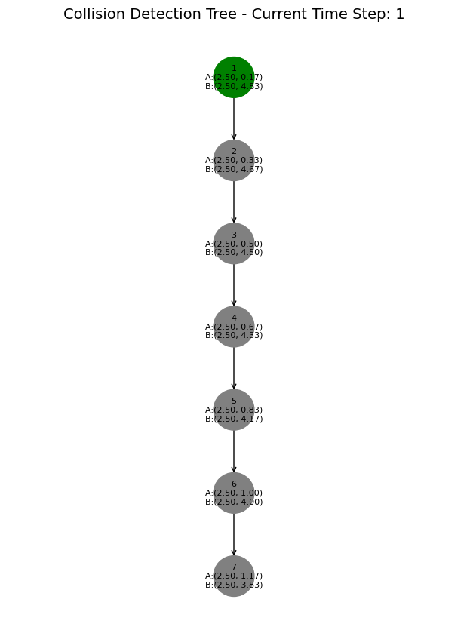
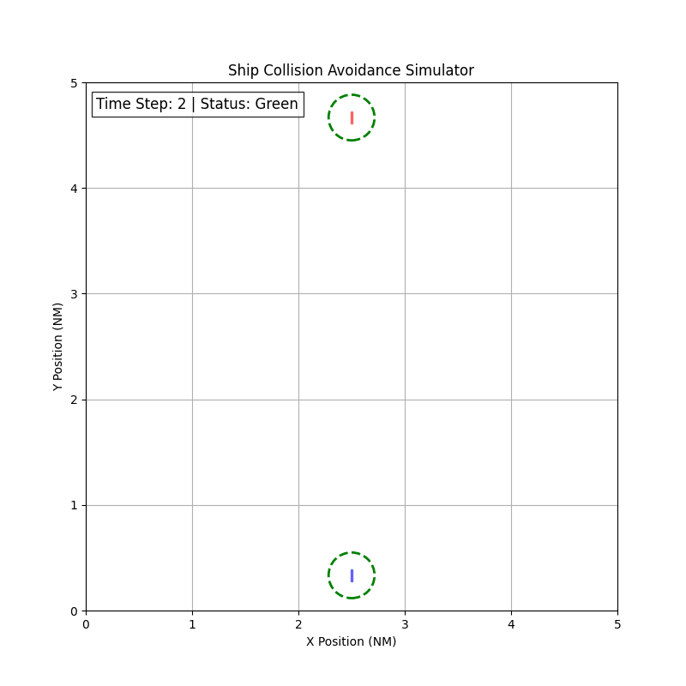
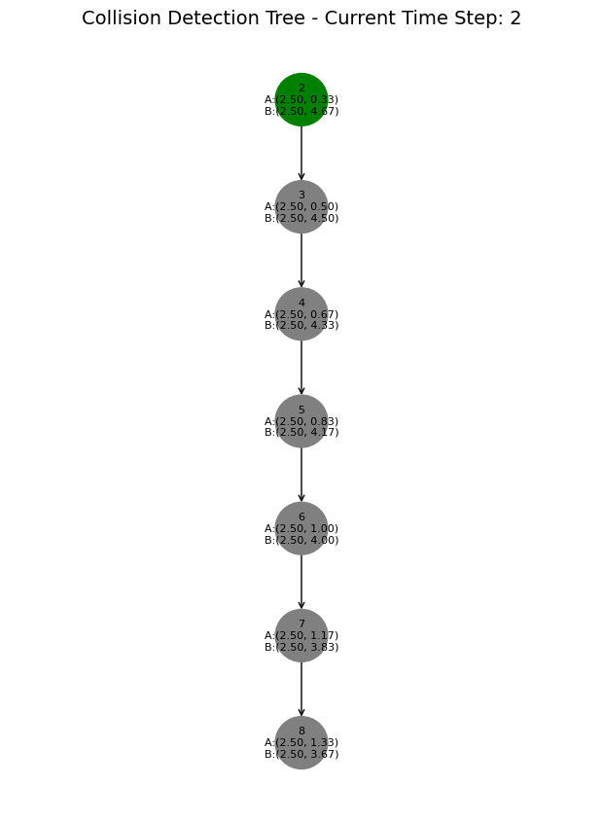
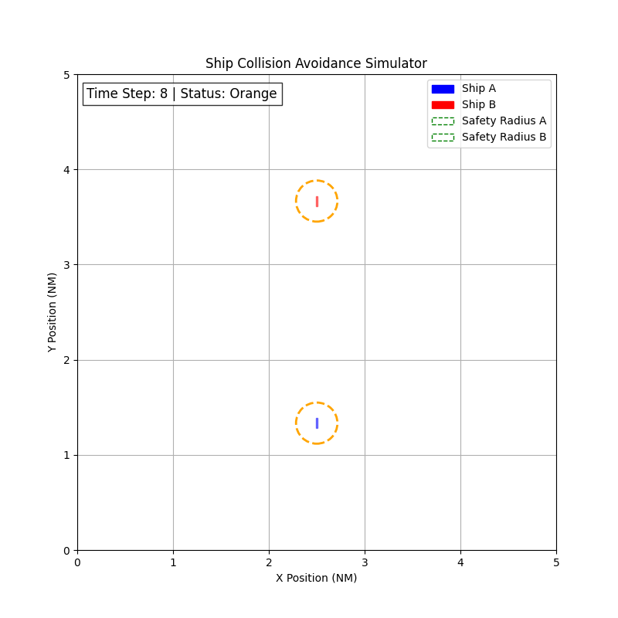
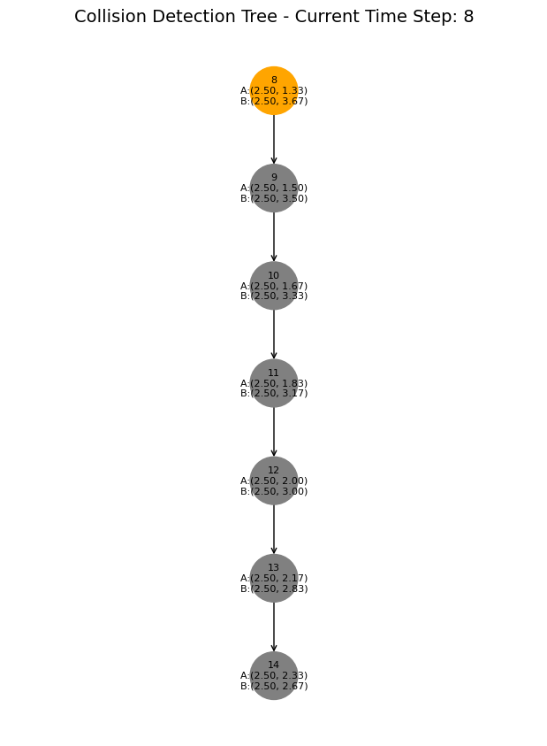



Slide 10
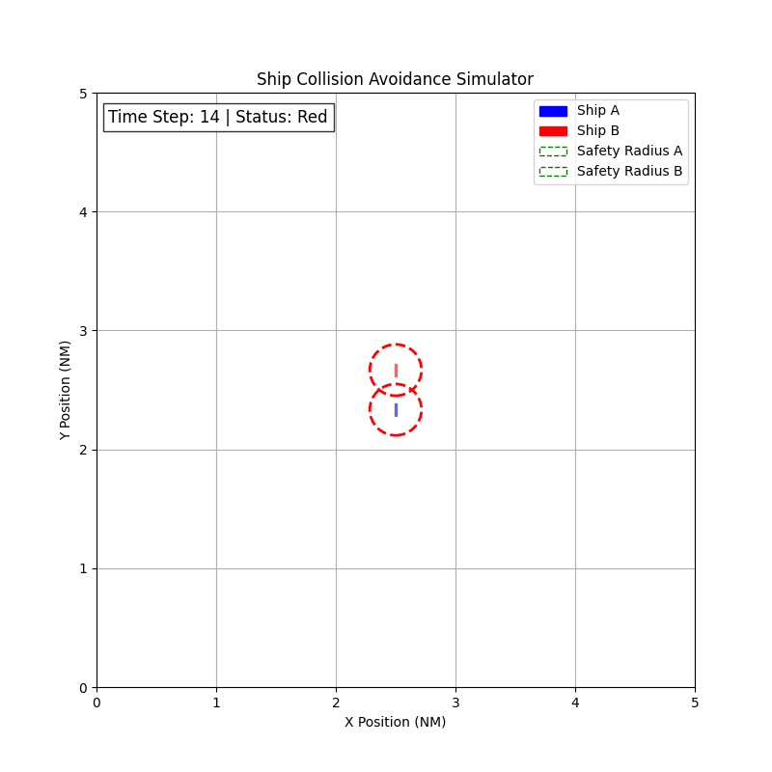
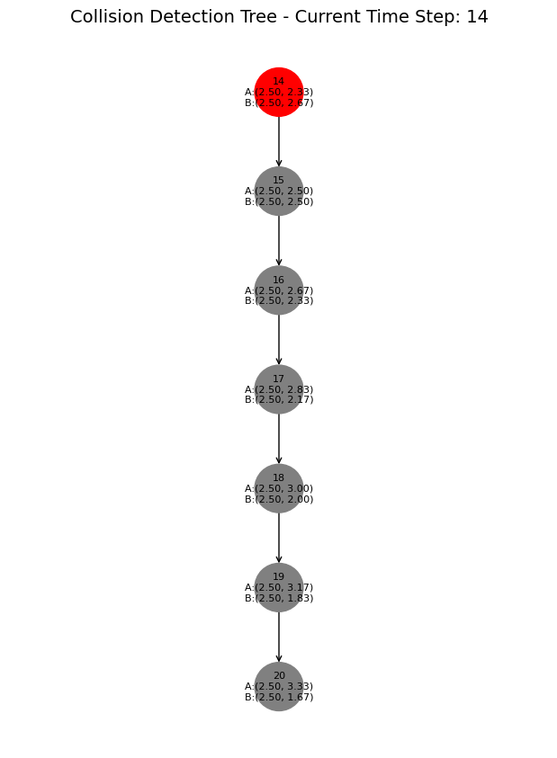
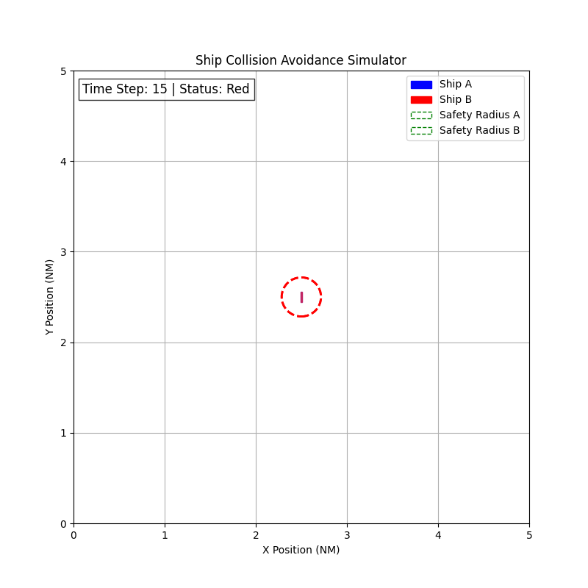
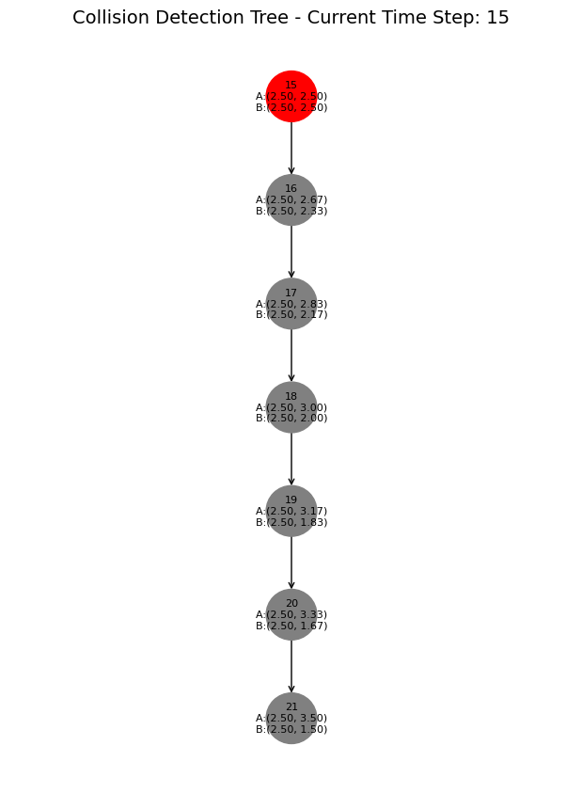

Slide 11
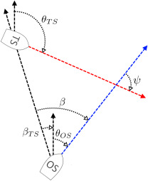
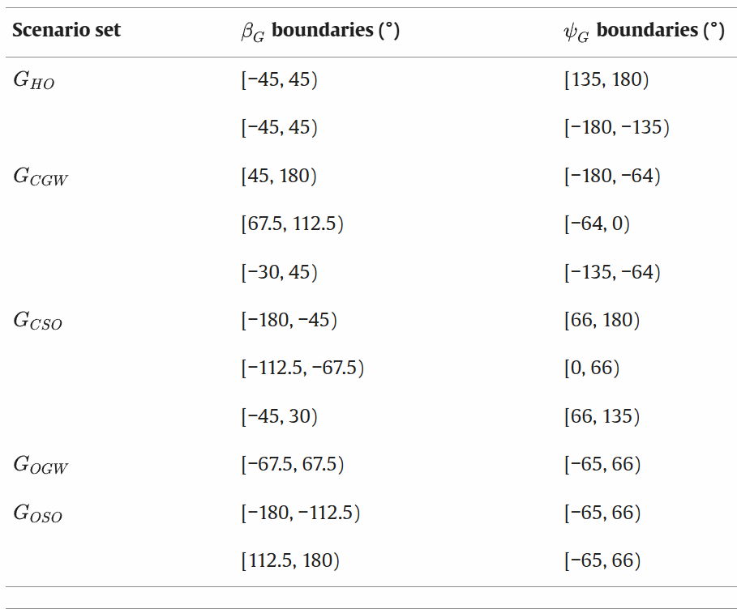
CLASSIFICATION
We use TAG-CSC(Temporal and Geometric COLREG Scenario classification) system, it’s a system to classify COLREG scenarios based on relative bearings of the ships.
Notes:
The process involves computing the angle between a ship's heading direction and the line-of-sight vector to another vessel. Specifically, for each ship, the system calculates the relative bearing by measuring the angle from the ship's current heading to the direction of the other ship's position

Slide 12
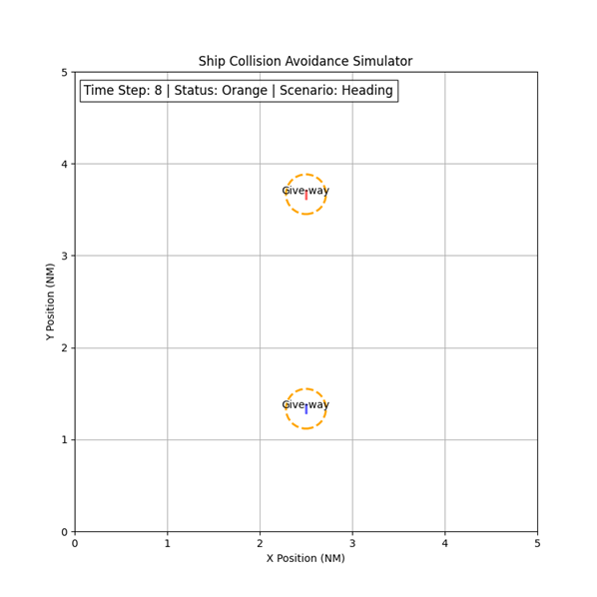
ROLES
After classifying the collision, we will apply roles for each vessel based on TAG-CSC system we expanded on earlier.
Notes:
Why is it important that we classify and applied roles, because now we can decide what action should each ship take in order to maneuver according to COLREG.

Slide 13
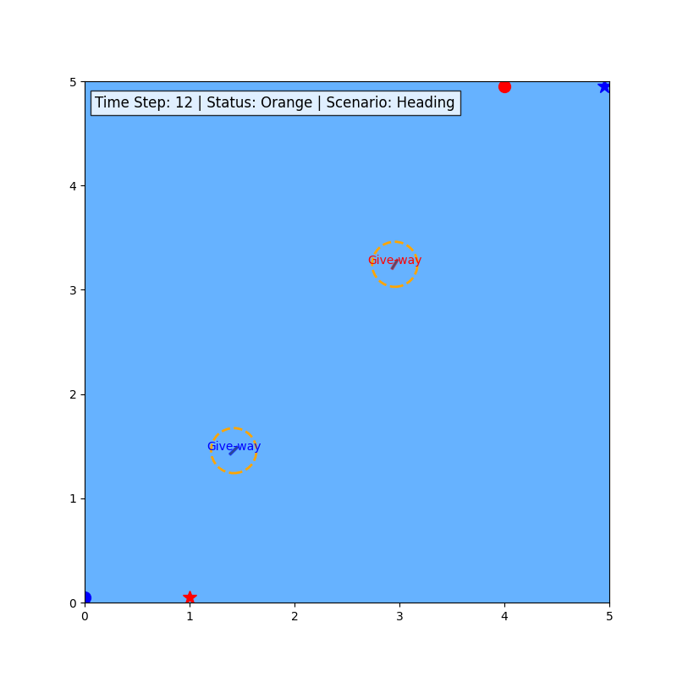
ALGORITHM
After detecting collision, classifying scenario and applying roles, the algorithm should kick in and handle the collision avoidance.
Notes:
We changed status because we found collision in the future, we classified the scenario and applied roles correctly – now the algorithm should kick in and generate a path that meet our goals – avoiding collision and compliance with COLREG.

Slide 14
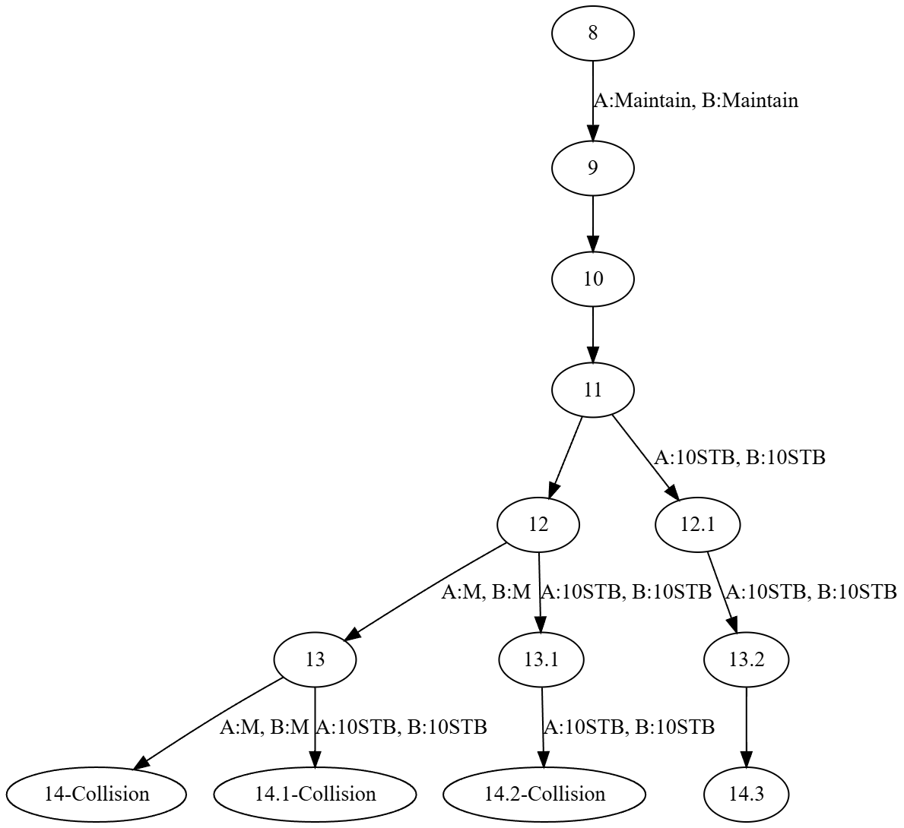
Tree search
Tree search is an algorithmic method used to explore possible states or decisions systematically.
Represents the problem as a tree where nodes signify states and edges denote actions or decisions.
Notes:
Second point – algorithms like DFS/BFS/A*.
We believe that tree search can be applied to our problem – where each state of the map will be represented as a node, and a search will be done to search for the best solution that fits our constraints ( Collision avoidance & COLREG ).

Slide 15
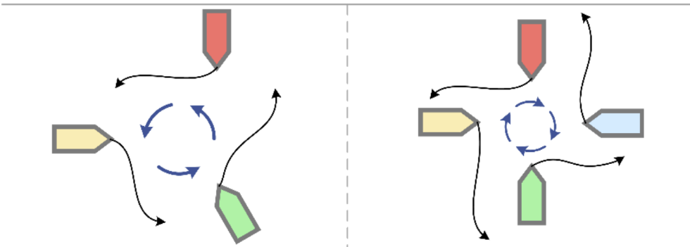
Multi-vessel SCENARIOs
Multi-vessel scenarios are defined in a general manner in COLREG (Rule 8).
Haven’t reached that yet, that’s an object for the next phase of the project.
Notes:
Still need to choose how to handle that
roundabout idea.

Slide 16
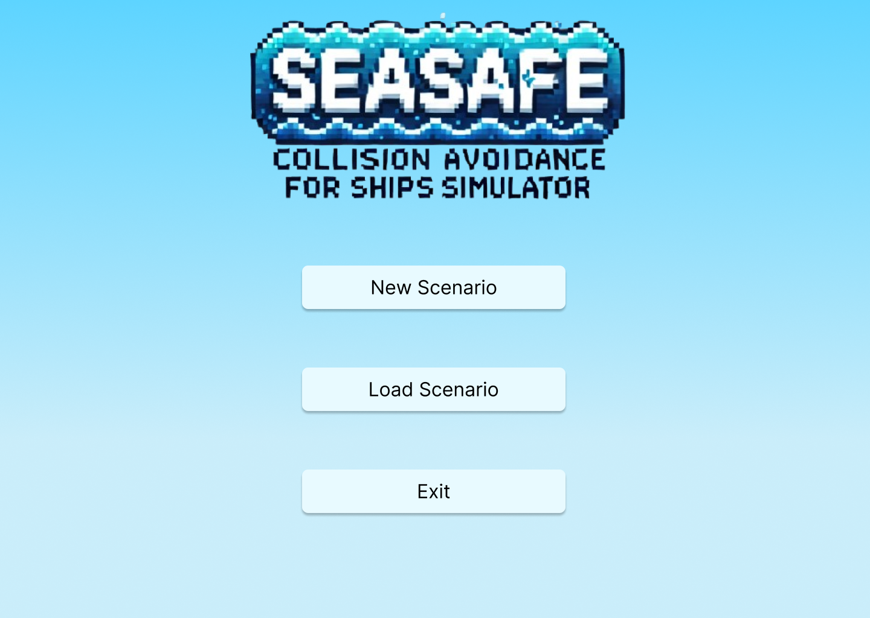
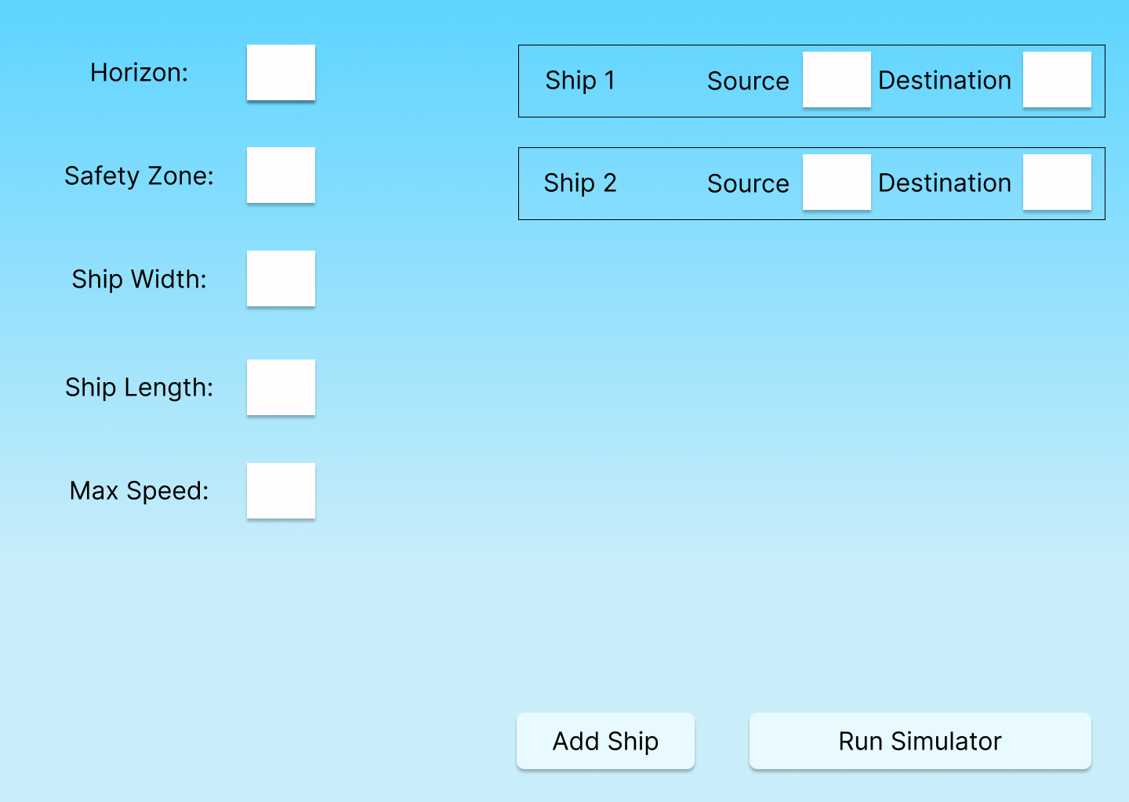
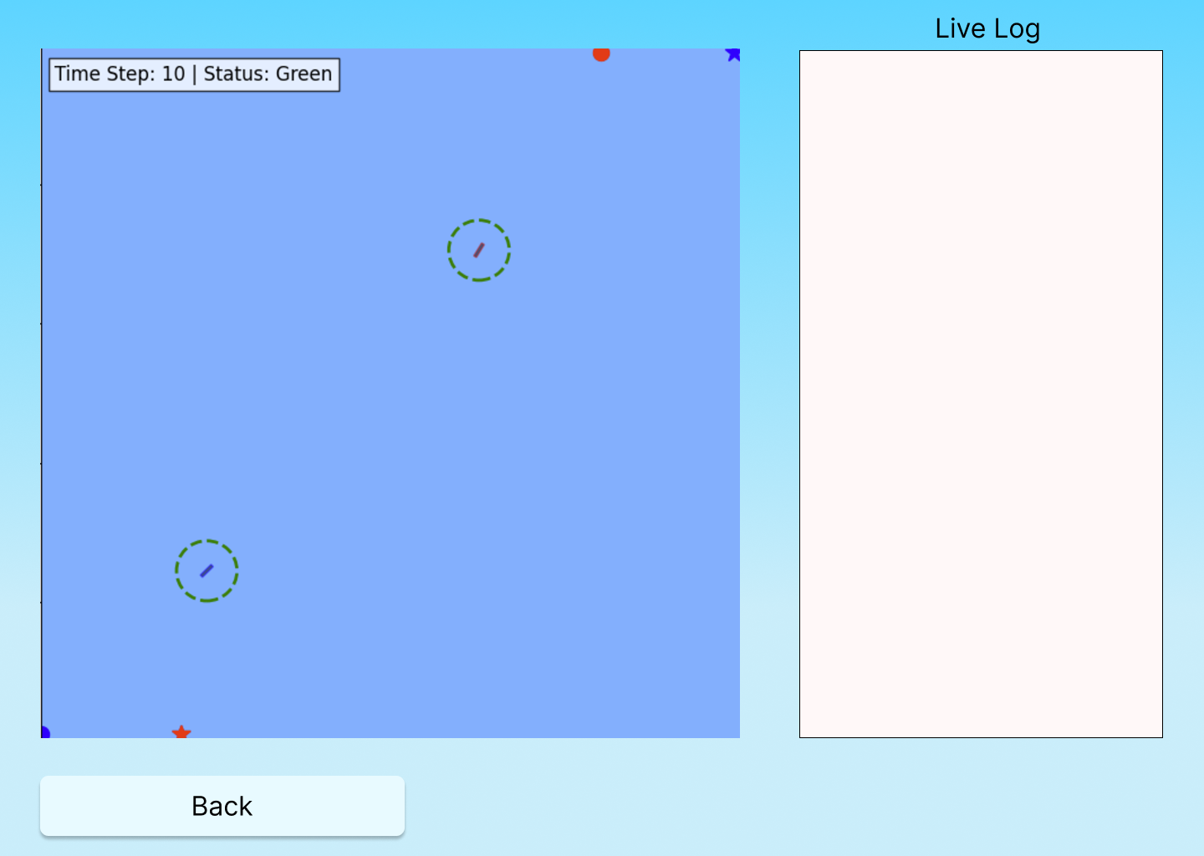
UI
Notes:
To test and validate the algorithm, a simulator will be developed.
The simulator will record a detailed trace (log file) for each run.
The user will be able to upload a trace/log file – a saved time step of a recorded run. He can load it and replay the scenario.

Slide 17
SOFTWARE architecture
- Modular Design:
- Separation of Concerns: Simulation Engine and Collision Avoidance Algorithm are independent modules.
- Algorithm Integration:
- Clear and Simple API
- Generic Interface:
API is not tied to a specific algorithm implementation.
Allows for easy substitution or updates to the algorithm.

Slide 18
CHALLENGES
Algorithm Scalability - As the number of vessels in the simulation increases, the computational complexity of predicting potential collisions and determining avoidance maneuvers grows significantly. The algorithm must be capable of processing information from multiple vessels and making real-time decisions without compromising performance. Ensuring scalability and computational efficiency is essential to handle complex scenarios involving many vessels simultaneously.
Verifying the algorithm - Verifying and validating the collision avoidance algorithm presents a significant challenge because it depends on the development of the simulator, which will happen in the second phase of the Capstone project.

Slide 19
Tools
In order to develop the simulator, we will use some well known technologies:
Python with PyGame
NumPy, Matplotlib and Networkx
Git for version control
PyTest for testing

Slide 20
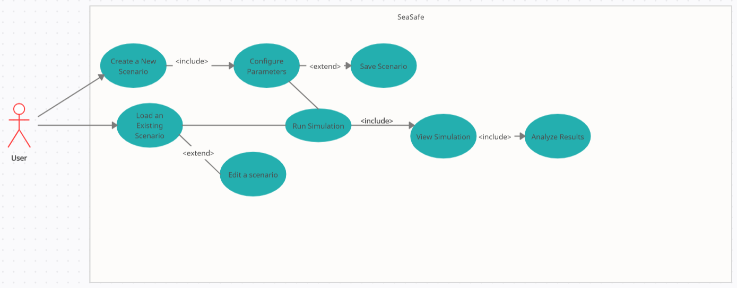
UML – USE CASE

Slide 21
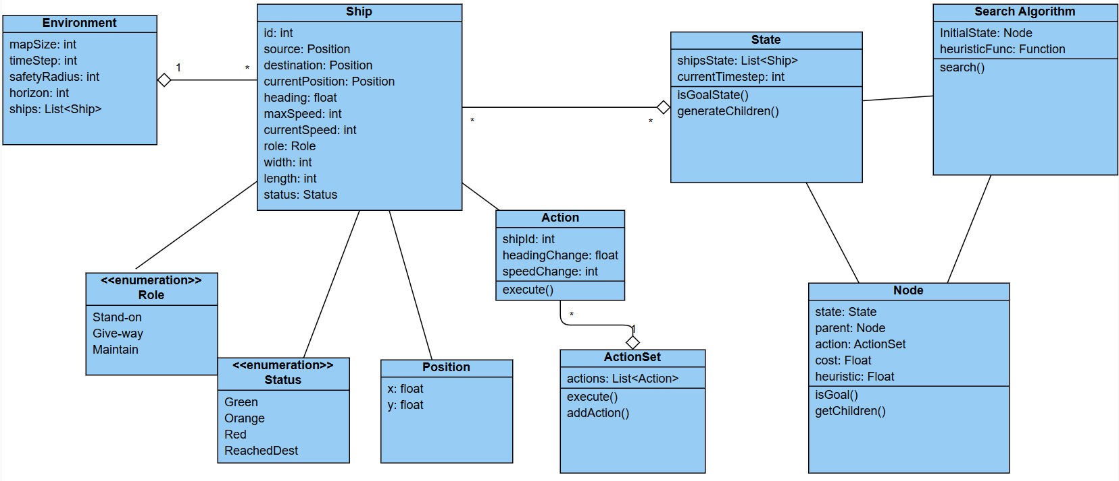
UML – CLASS DIAGRAM

Slide 22
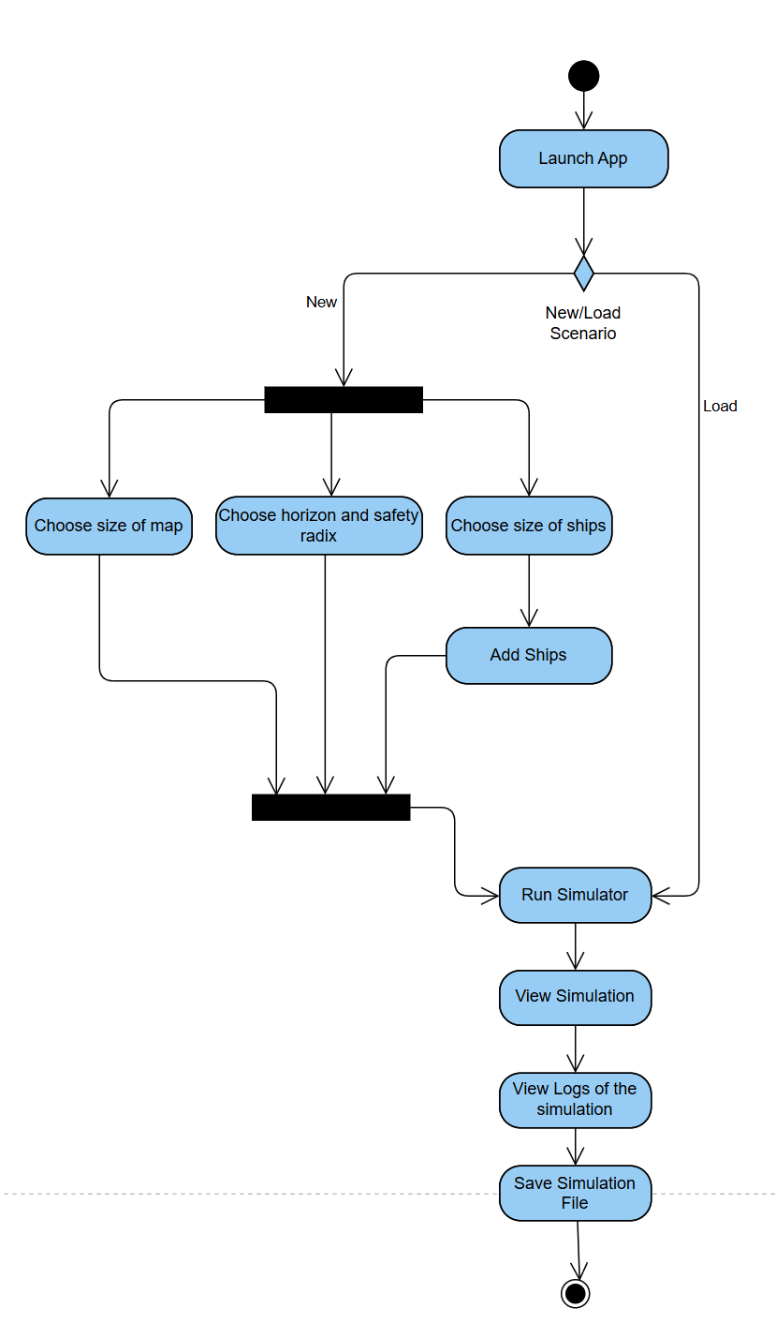
Uml – ACTIVITY DIAGRAM

Slide 23
EVALUATION CRITERIAS
Collision Detection
Demonstration of the collision detection capability using the simulator.
30 different scenarios, each scenario will include 2 to 8 ships with different source, destinations and speeds.
Ships with no risk of collision in the checked horizon will be marked with green circles, ships who are at risk of collision – orange circles, ships who enter each other’s safety zone – red circles.
Collision Avoidance – 2 vessel
Demonstration of the collision avoidance capability in a 2-vessel scenario using the simulator.
For each scenario (head on, crossing and overtaking) 10- different scenarios will be demonstrated.
Roles of the ships for the avoidance maneuver will be clearly marked in the simulator UI.
Collision Avoidance – >2 vessels
Demonstration of the collision avoidance capability in a 3-4 and 5 -vessel scenario using the simulator.
For each scenario (3,4,5 vessels) 5-different scenarios will be demonstrated.

Slide 24
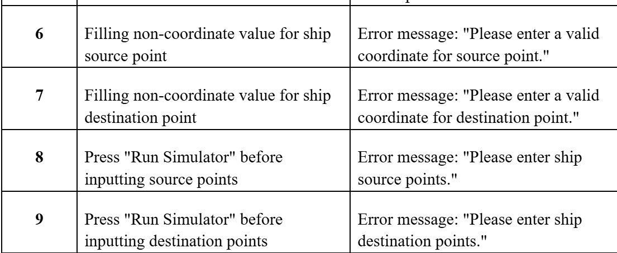
Testing plan
Unit testing
Integration testing
Simulation testing
Example of test cases:
Notes:
First, unit testing to check that each part of the system is working well.
Next, integration testing to make sure all parts of the system work well together.

Slide 25
EXPECTED RESULTS
A COLREG-compliant collision avoidance algorithm capable of handling complex, multi-vessel scenarios.
A simulation system for testing and visualizing the algorithm's performance under various conditions.

Slide 26
Thank you for LISTENING

